Slide 1
Capstone Project 3 Email Campaign Effectiveness Prediction
Individual Project By:
GULAM SARVAR
mailto:sheikhgulamsarvar@gmail.com

Slide 2
Content
● Problem Statement ● Email Campaign Effectiveness Prediction
● Data Summary ● Approach
● Exploratory Data Analysis ● Correlation Matrix
●Variable Importance
● Modeling:
● Model Performance and Evaluation Metrics
● Conclusion and Recommendations

Slide 3
● Problem Statement
Most of the small to medium business owners are making effective use of Gmail-based Email marketing Strategies for offline targeting of converting their prospective customers into leads so that they stay with them in business. The main objective is to create a machine learning model to characterize the mail and track the mail that is ignored; read; acknowledged by the reader. Data columns are self-explanatory.

Slide 4
Email Campaign Effectiveness Prediction
Email Marketing can be defined as a marketing technique in which businesses stay connected with their customers through emails, making them aware about their new products, updates, important notices related to the products they are using. Most importantly, email marketing allows businesses to build relationships with leads, new customers and past customers. It's a way to communicate directly to the customers in their inbox, at a time that is convenient for them. With the right messaging tone and strategies, emails are one of the most important marketing channels. But many of times as customers we do not tend to read an email due to a number of reasons - to name a few would be no proper structure, too many images, too many links inside the mail, complex vocabulary used or simply too long emails.

Slide 5
Data Summary
● Email Id - It contains the email id's of the customers/individuals
● Email Type - There are two categories 1 and 2. We can think of them as marketing emails or important updates, notices like emails regarding the businesses.
● Subject Hotness Score - It is the email's subject score on the basis of how good and effective the content is
● Email Source - It represents the source of the email like sales and marketing or important admin emails related to the product
● Email Campaign Type - The campaign type of the email
● Total Past Communications - This column contains the total previous emails from the same source, the number of communications had
● Customer Location - Contains demographical data of the customer, the location where the customer resides
● Time Email sent Category - It has three categories 1,2 and 3; the time of the day when the email was sent, we can think of it as the morning, evening, and night time slots.
● Word Count - The number of words contained in the email
● Total links - Number of links in the email
● Total Images - Number of images in the email
● Email Status - Our target variable which contains whether the mail was ignored, read acknowledged by the reader

Slide 6
● Approach
The approach followed here is to first check the sanctity of the data and then understand the features involved. The events followed were:
● Data cleaning and preprocessing- finding null values and imputing them with appropriate values.
● Exploratory data analysis of categorical and continuous variables against our target variable.
● Data manipulation- feature selection and engineering, handling multicollinearity with the help of VIF scores feature scaling and encoding.
● Handling Class Imbalance- our dataset was highly imbalance with 80% majority, strategy was to splitting the stratified dataset and under sampling and oversampling with SMOTE on the train sets only so that our test set remains unknown to the models
● Modeling- worked on an evaluation code which was frequently used to evaluate the same models on under sampled and oversampled data in one go,logistic regression, decision trees, random forest, KNN and XGB were run to evaluate the results and then concluded on the basis of model performance and some recommendations were made to improve the numbers of read and acknowledged emails.

Slide 7
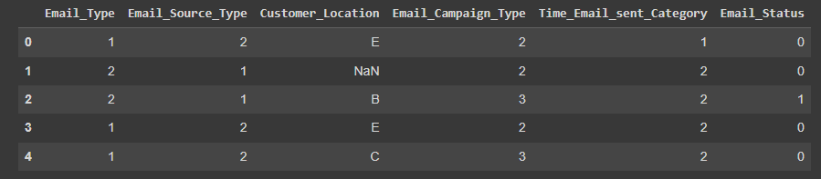
Exploratory Data Analysis:-- We did a detailed exploratory data analysis of the categorical and continuous variables against their target variable and these are few important insights we got:
1. Categorical Variable
An overview of the categorical Variable dataset:--

Slide 8
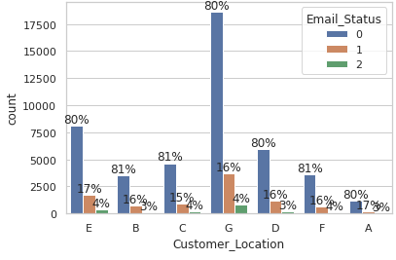
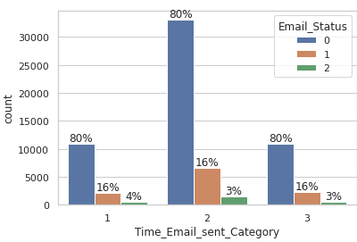
Continued:--
This is the count plot of categorical variable customer location, email type, which shows one type of data is more as compared to another.
In the customer location feature we can find that irrespective of the location, the percentage ratio of emails being ignored, read and acknowledge are kind of similar. It does not exclusively influence our target variable. It would be better to not consider location as factor in people ignoring, reading or acknowledging our emails.
.

Slide 9
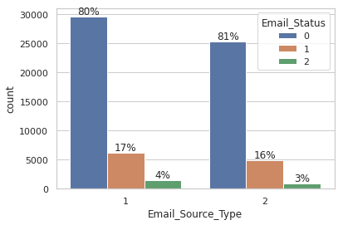
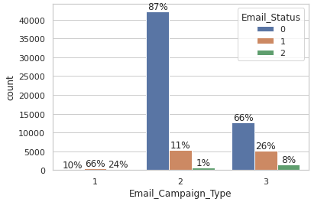
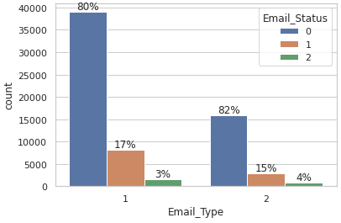
Continued:--
In the Email Campaign Type feature, it seems like in campaign type 1 very few emails were sent but has a very high likelihood of getting read. Most emails were sent under email campaign type 2 and most ignored. Seems like campaign 3 was a success as even when less number of emails were sent under campaign 3, more emails were read and acknowledged.

Slide 10
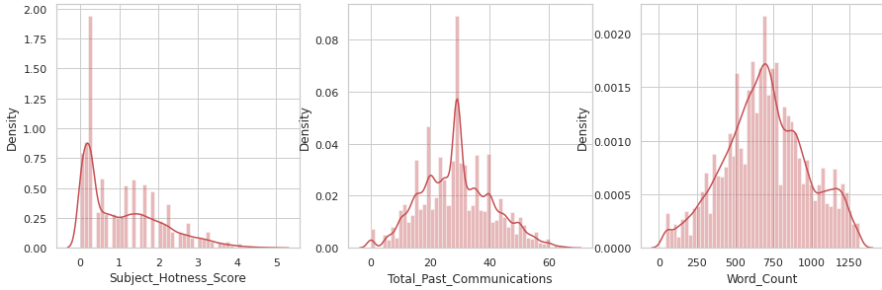
Continued:-- 2. Continuous Type Variable
● Analyzing total past communications, we can see that the more the number of previous emails, the more it leads .to reading and acknowledged emails. This is just about making a connection with your customer.
● More images were there in ignored emails.

Slide 11
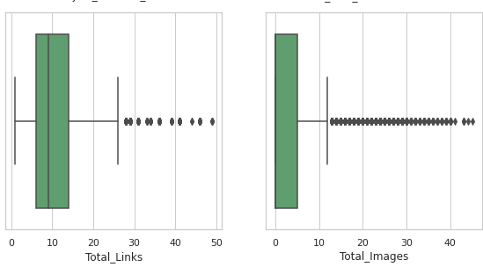
Continued:--
● There are outliers in almost every continuous variable except Word Count and upon analyzing, it was found that outliers make up for more than 5% of the minority data and will influence the results either way, so it was better not to get rid of them.

Slide 12
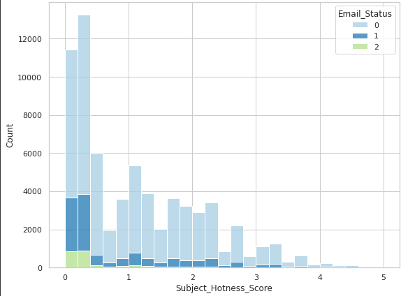
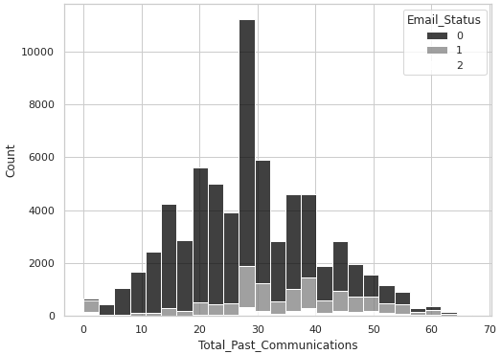
Continued:--
This is a combination count plot of subject hotness score with the email status, and second is combination of email status with total past communication

Slide 13
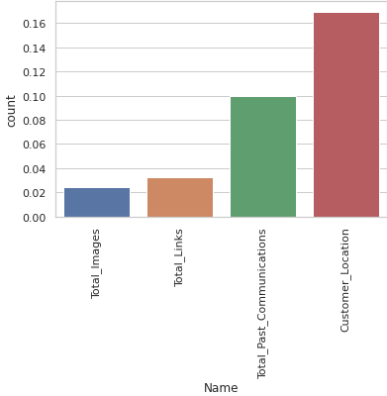
Continued:--
From the missing count plot, we can see
that Customer location has a maximum
Number of missing values or NaN values
Inside The data frame
this is later corrected by the mean.

Slide 14
Correlation Matrix
Correlation is a statistical term used to measure the degree in which two variables move in relation to each other.
A perfect positive correlation means that the correlation coefficient is exactly 1.
This implies that as one variable move, either up or down, the other moves in the same direction.
A perfect negative correlation means that two variables move in opposite directions, while a zero correlation implies no linear relationship at all.

Slide 15
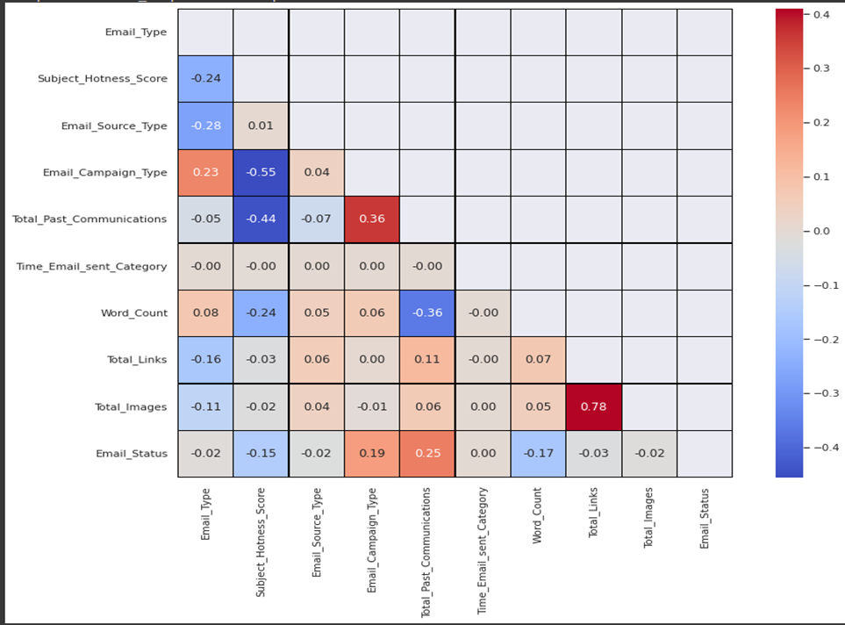

Slide 16
Observation from Correlation Matrix
Email Campaign Type and Total past communication show a positive correlation with emails being read and acknowledged. Word Count and Subject Hotness scores are the most negative among others. We can see multicollinearity involved in Email Campaign Type, Total past communication and Total links, and Total Images among others and we will have to deal with it.

Slide 17
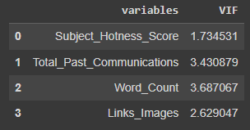
Variable Importance's
The Variable importance is found with the help of VIF factor..
When two or more independent variables have
Exact linear relationship between then
Called multicollinearity.
VIF=1 [No multicollinearity]
VIF<=5[moderately correlated]
VIF>=5[highly correlated]

Slide 18
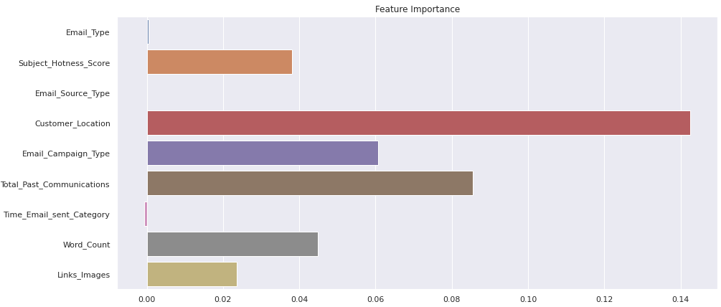
Continued:--

Slide 19
Observation from feature importance plot:-
From plot, we can see that customer location, email campaign type, and total past communication have more importance for the machine learning model.
Email source type, email type, and total email sent category to have less or no important for machine learning model.
So we can drop the email source type total email sent category for fitting the machine learning model.
email id is also dropped for machine learning model.

Slide 20
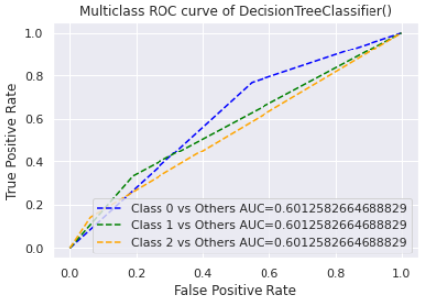
Machine Learning Model:--
Decision Tree Model:
Decision tree uses the tree representation to
solve the problem in which each leaf node corresponds to a class label and attributes are
represented on the internal node of the tree.
This curve shows the rate of true positive vs false positive rate
Class 0 it has a high true positive rate.

Slide 21
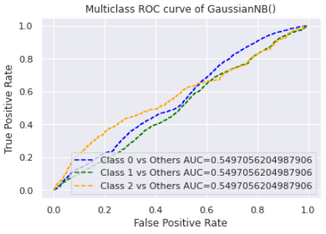
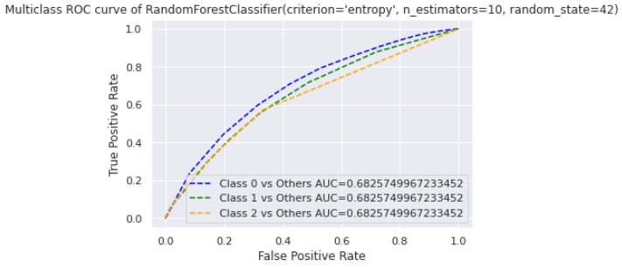
Continued:--
Naive Bayes classifier:
As compare to decision tree classifier naïve Bayes has lower AUC value
Random Forest
It has a higher AUC value.

Slide 22
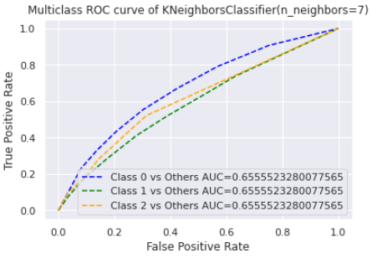
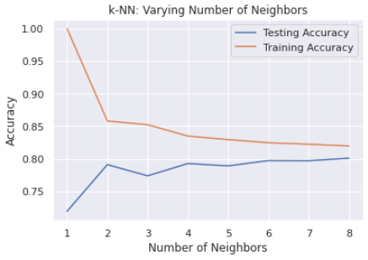
Continued:--
KNeighborsClassifier:
As increasing the number of neighbors the accuracy for training data is decreases, while accuracy of test data is increases than at an number accuracy for training and test data is become constant.

Slide 23
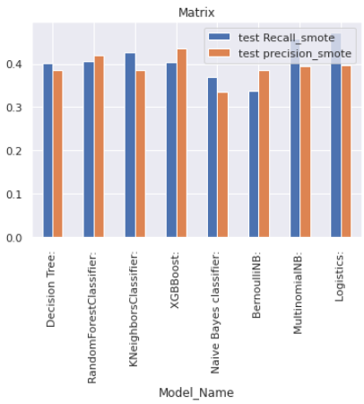
Continued:--
The recall is calculated as the ratio between the number of Positive samples correctly classified as Positive to the total number of Positive samples. The recall measures the model's ability to detect positive samples. The higher the recall, the more positive samples detected.
Precision is one indicator of a machine learning model's performance – the quality of a positive prediction made by the model.
From the bar plot, we can see that Bernoulli NB has the highest Recall (in Smote)
And Multinomial NB,XGB Boost and Logistics have the highest precision. (in Smote)

Slide 24
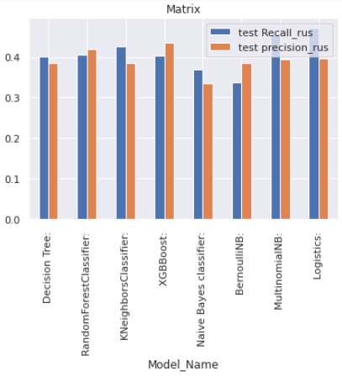
Continued:--
This bar plot is under in rus..
From the bar plot, we can see that Bernoulli NB has the highest Precision(in RUS)
And Multinomial NB,XGB Boost and Logistics have the highest recall. (in RUS)

Slide 25
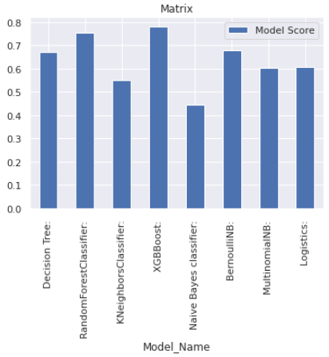
Continued:--
A model scoring is an AI Studio operator that stores the value predicted by a supervised learning model for the objective field.
From this plot we can see a list of scores:--
XGBoost=0.78
RandomForestClassifier=0.75
BernaulliNB=0.677
Decision tree=0.67

Slide 26
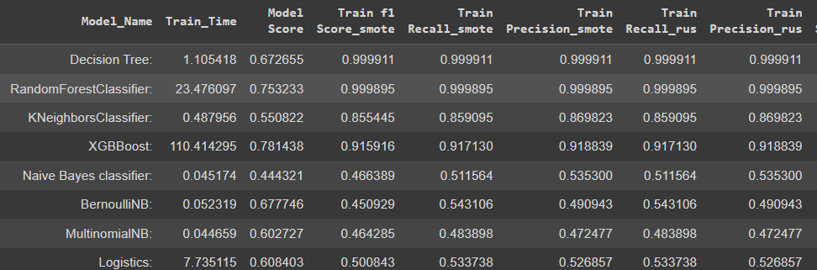
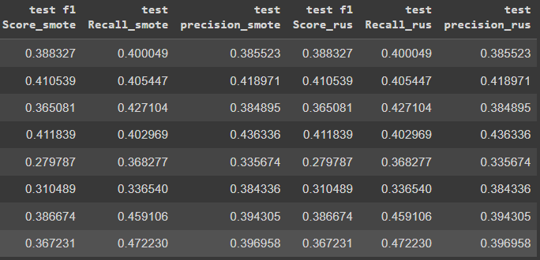
Continued:--

Slide 27
Conclusion
● Email Campaign Types 1 and 3 are doing better than 2. So, focusing on improving 2, can do the trick.
● The word count should be reasonable. The content should be crisp and to the point with a few marketing gimmicks.
● The number of images and links should be kept in check.
● Total past communications had a positive influence, hence having a healthy relationship with customers is a big yes.

Slide 28

GULAM SARVAR

